Slide 1

UM
Data Science
2024-2025
Crop Production Analysis
Unified Mentor
This Project is assigned by Unified Mentor in the domain of Data Science Internships Course.
2024-2025
www.website.com

Slide 2

UM
Data Science
01
Introduction of Project
Brief introduction of the project and its short description.
02
Main Objective
Our Objective towards the project and what we except from the tasks.
03
Details Of Datasets
Brief description about the datasets like rows, columns, size, locations etc
04
Visualization & Storytelling
It consists of Data Visualization, Dashboards and all insights required for decisions

Slide 3
UM
Data Science
01
Introduction Part
Our Indian Agricultural fields consists of different crops and plants, this crops plays an important role on the whole ecosystem of life. So we need to take atmost care with the help of technologies and capital to sustained this things for the present and future generation. Our Crop Analysis Project will help in the analysing the different type of crops based on the location, season, availabilty etc
PART ONE

Slide 4
UM
Data Science
02
Objective Details
The main objective behind the taks is to analysed the different crops in the country and draw some effective insights and decisions from the visualization.
PART TWO
www.website.com

Slide 5
UM
Data Science
Details of the Dataset:-
The datasets consists of various types of crops with its state and location.
It also consists production year and area required for the crops to grow.

Slide 6
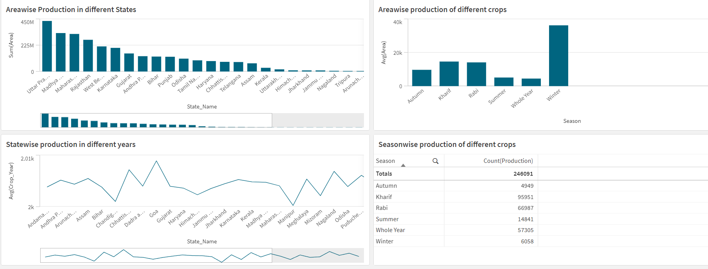
Visualization and Dashboard:-

Slide 7
UM
Data Science
THANK YOU
2024-2025
www.website.com

